Slide 1

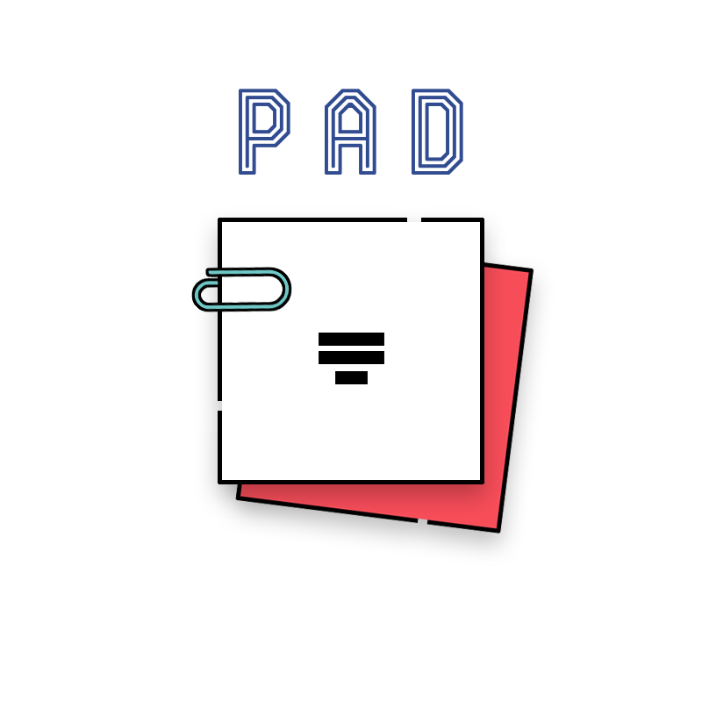







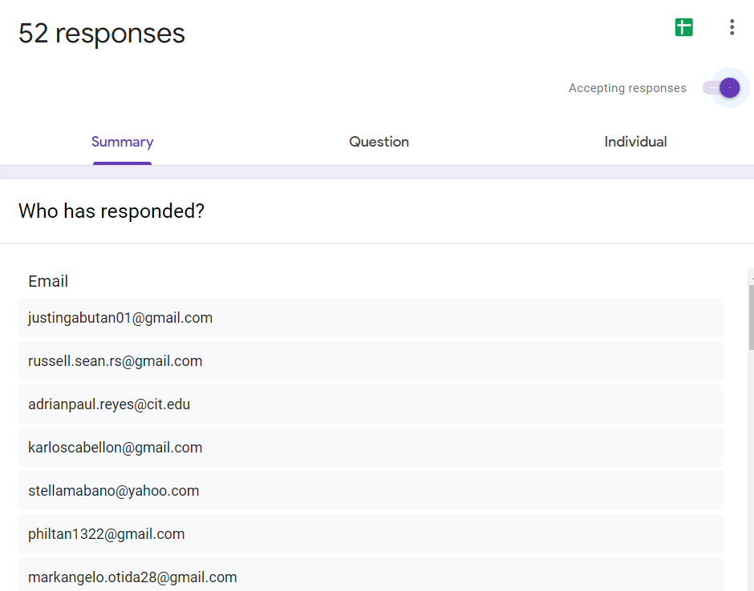
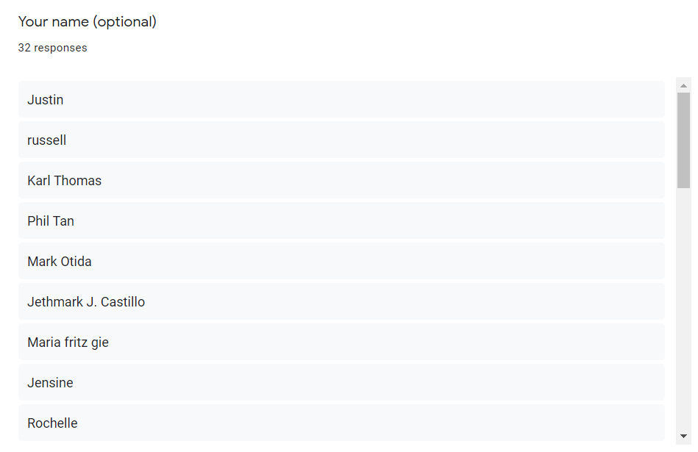
SURVEY RESULTS
Pad: User Satisfaction Survey Link
https://docs.google.com/forms/d/e/1FAIpQLSegTaXcrGP5l5JNeucbxfqY3LrhQg7BpXQbKmd9UAWt43h2mw/viewform

Slide 2


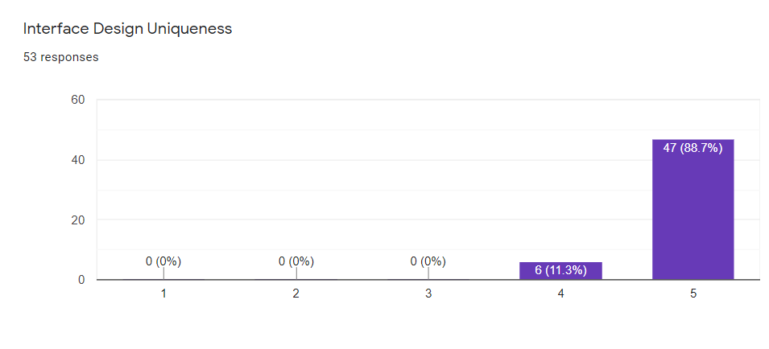
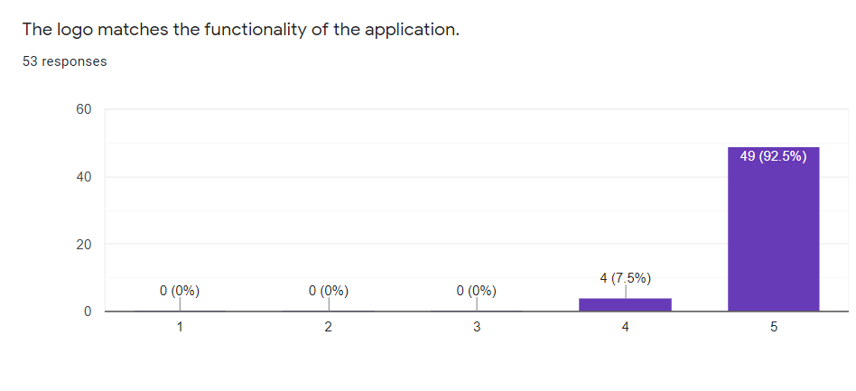



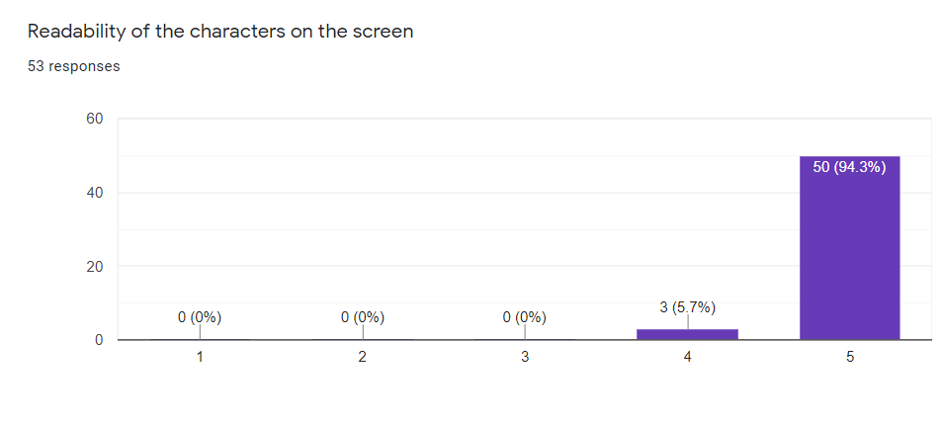
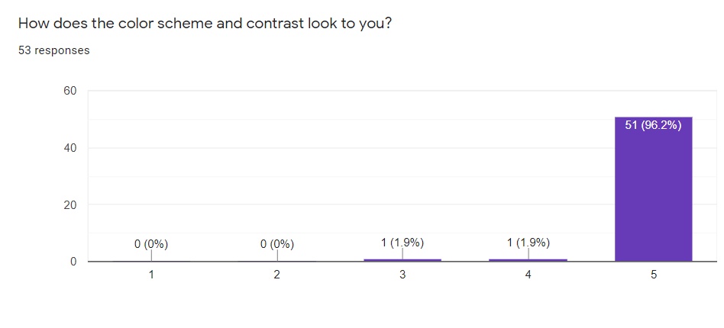


Interface Design Uniqueness
The logo matches the functionality of the application
How does the color scheme and contrast look to you?
Readability of the characters on the screen
SURVEY RESULTS
Pad: User Satisfaction Survey Link
https://docs.google.com/forms/d/e/1FAIpQLSegTaXcrGP5l5JNeucbxfqY3LrhQg7BpXQbKmd9UAWt43h2mw/viewform

Slide 3
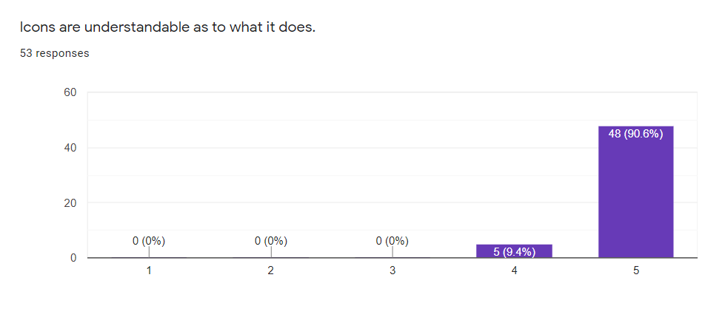
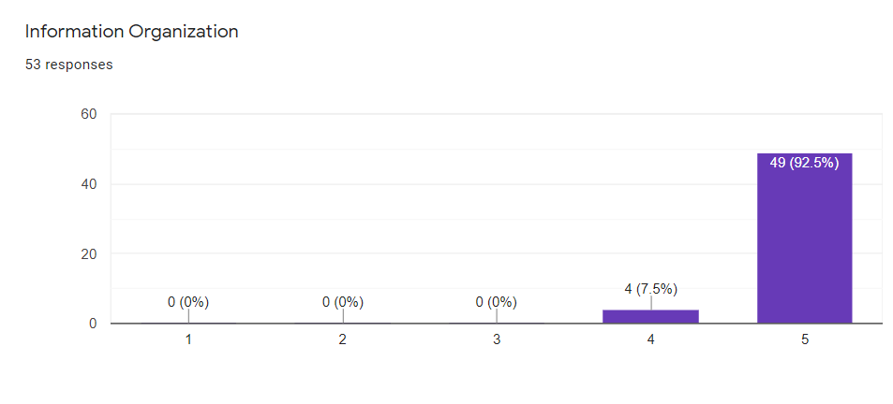
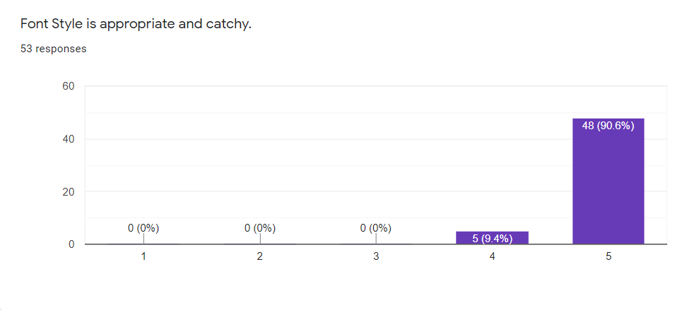

Icons are understandable as to what it does.
Information Organization
Font Style is appropriate and catchy.
Icons, texts and design layout positioning
Interface Design Uniqueness
The logo matches the functionality of the application
How does the color scheme and contrast look to you?
Readability of the characters on the screen

Slide 4
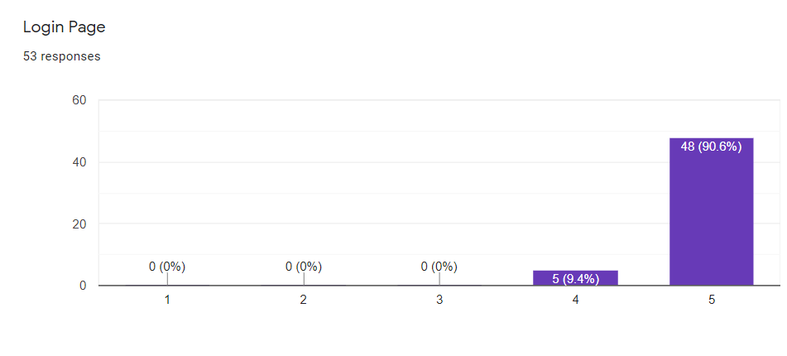
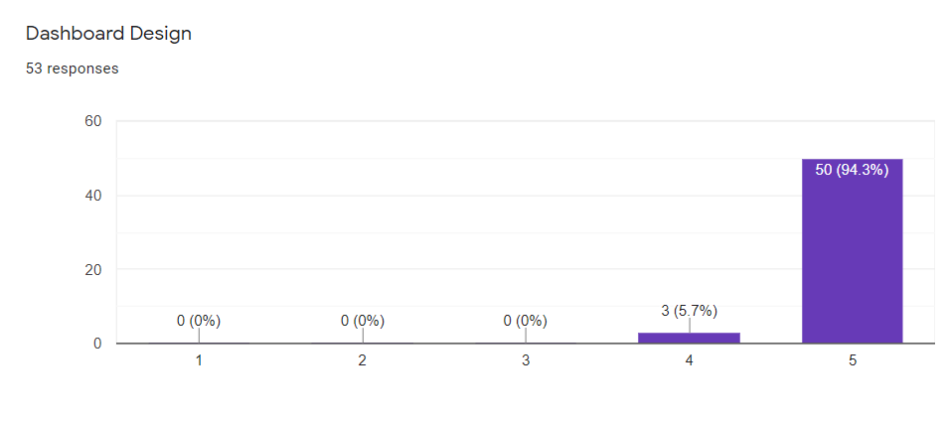
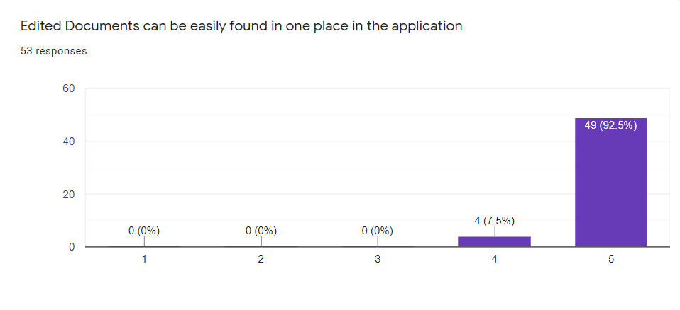
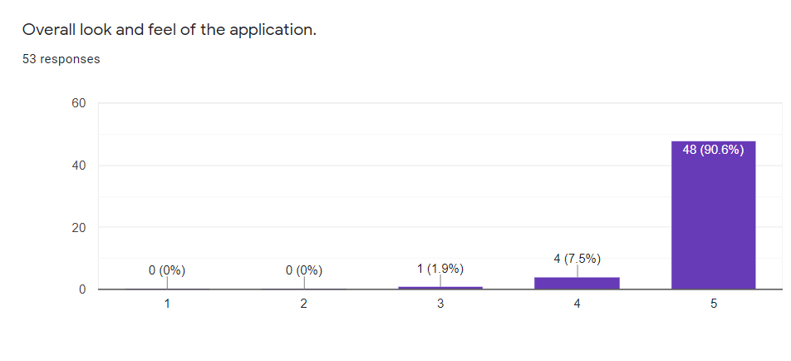
Login Page
Dashboard Design
Edited Documents can be easily found in one
place in the application
Overall look and feel of the application.
Icons are understandable as to what it does.
Information Organization
Font Style is appropriate and catchy.
Icons, texts and design layout positioning

Slide 5
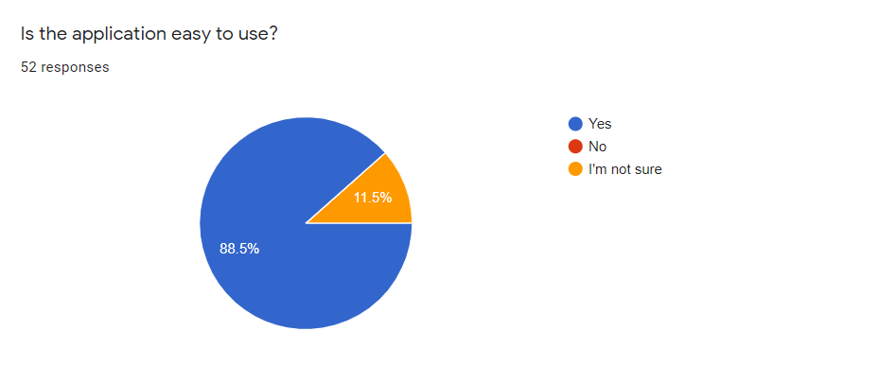
Is the application easy to use?
Login Page
Dashboard Design
Edited Documents can be easily found in one
place in the application
Overall look and feel of the application.

Slide 6
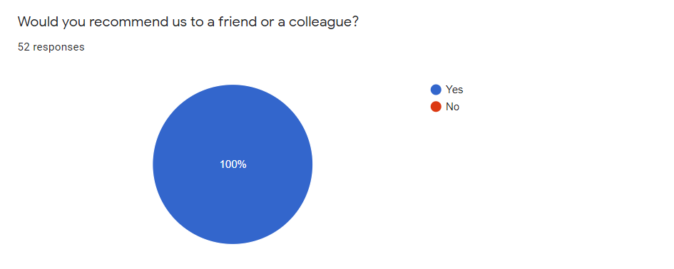
Would you recommend us to a friend or a colleague?
Is the application easy to use?

Slide 7
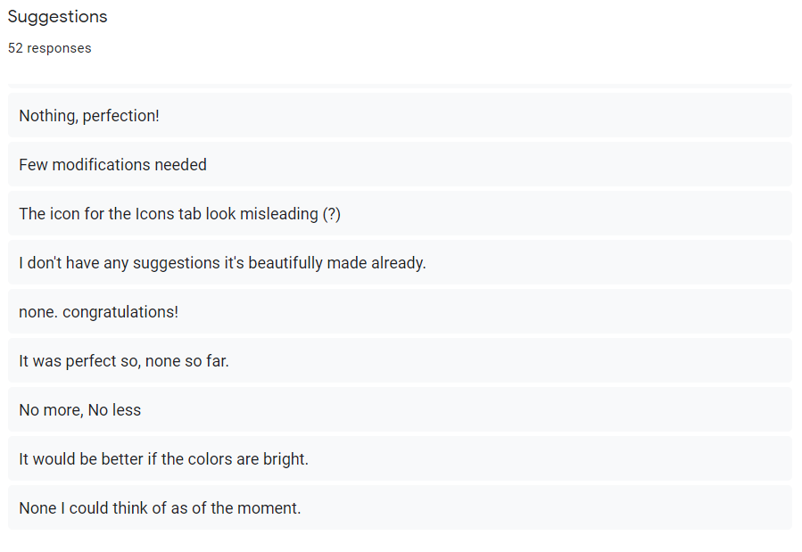
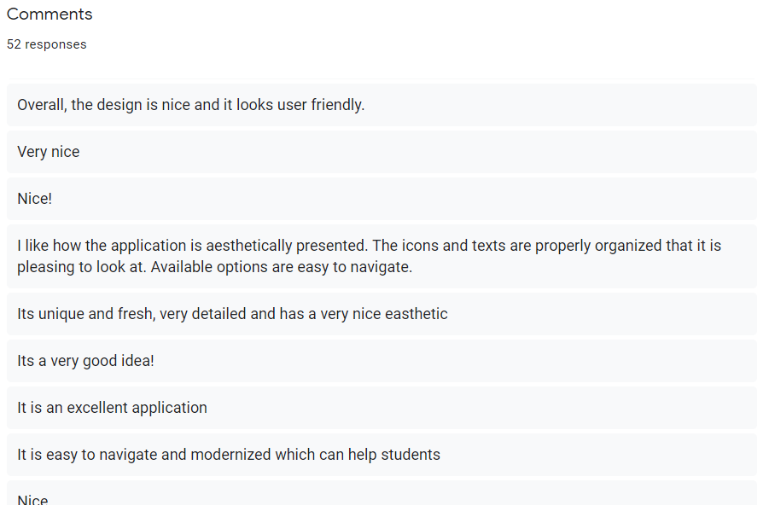
Suggestion
Comments
Would you recommend us to a friend or a colleague?

Slide 8
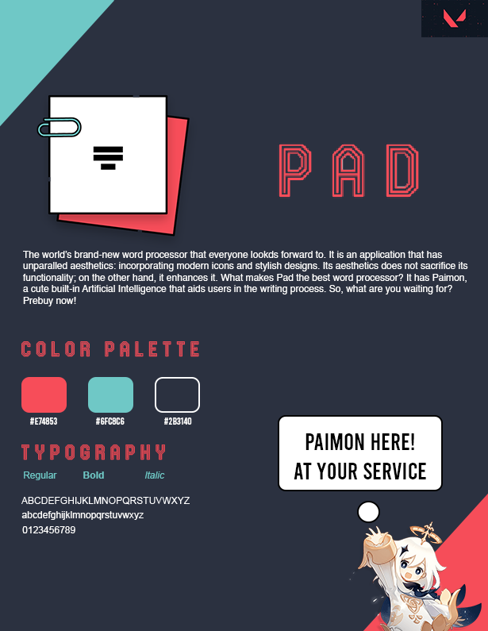
PAD’S USER INTERFACE
Suggestion
Comments

Slide 9
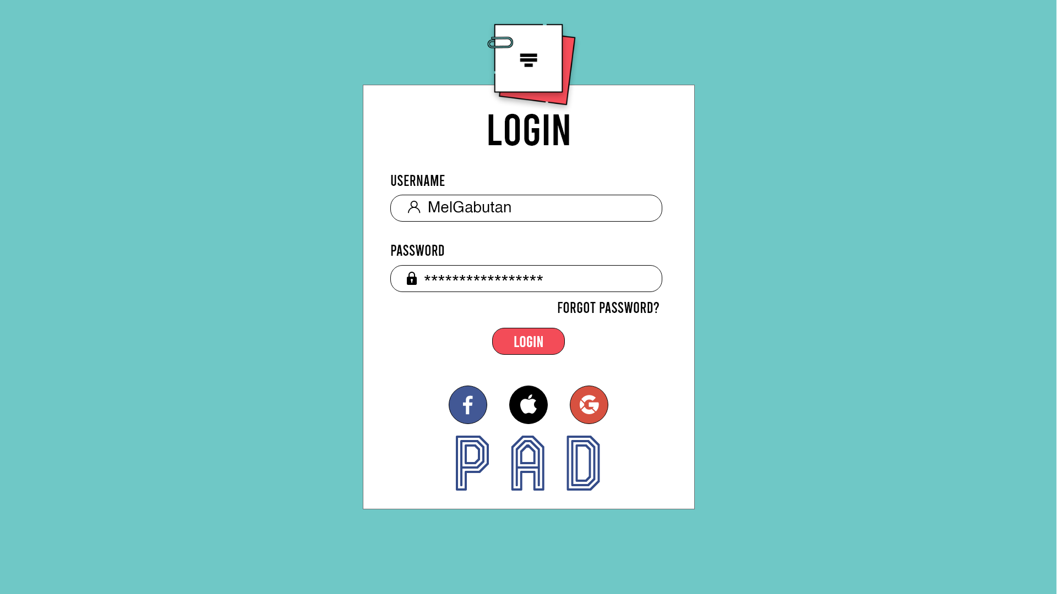

Log - in
PAD’S USER INTERFACE

Slide 10
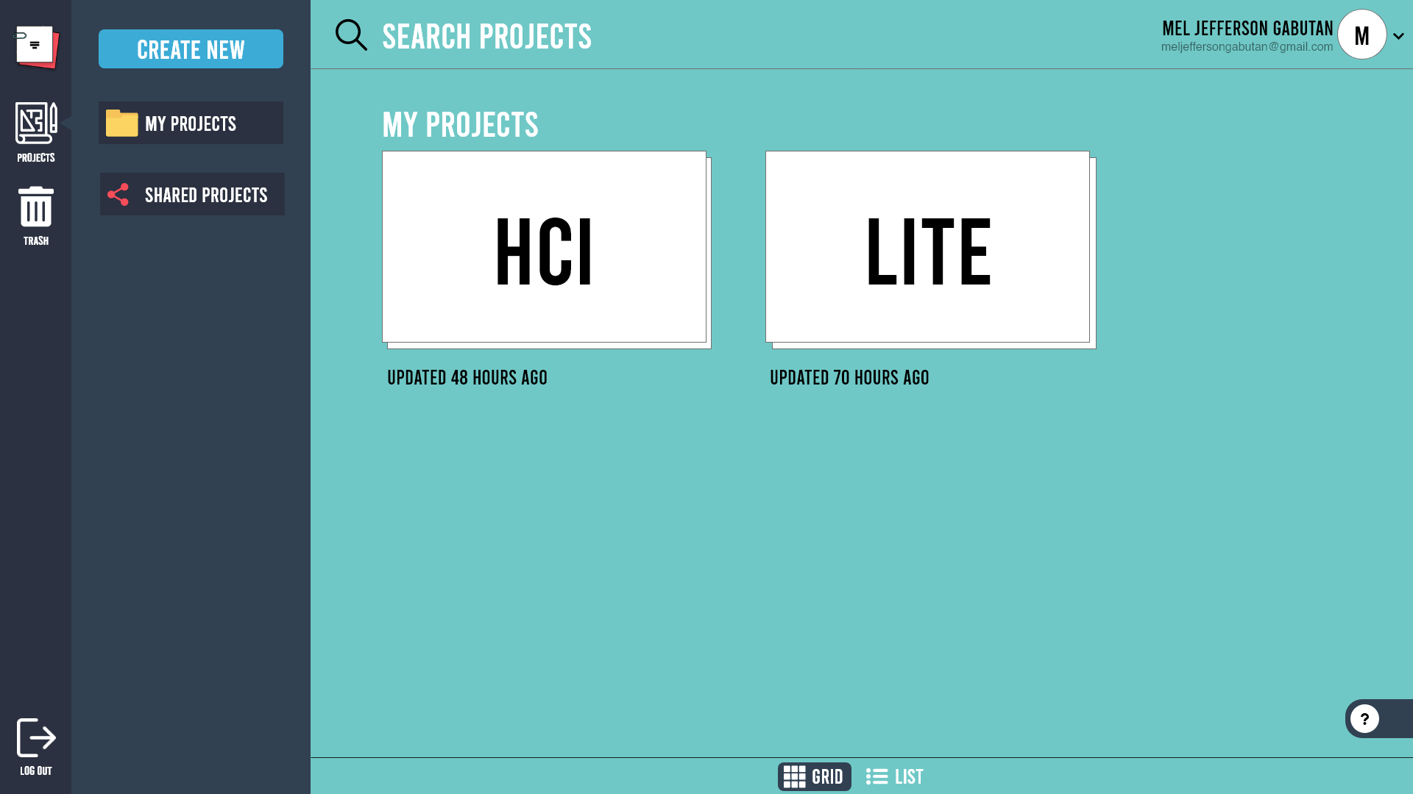
dashboard
Log - in

Slide 11
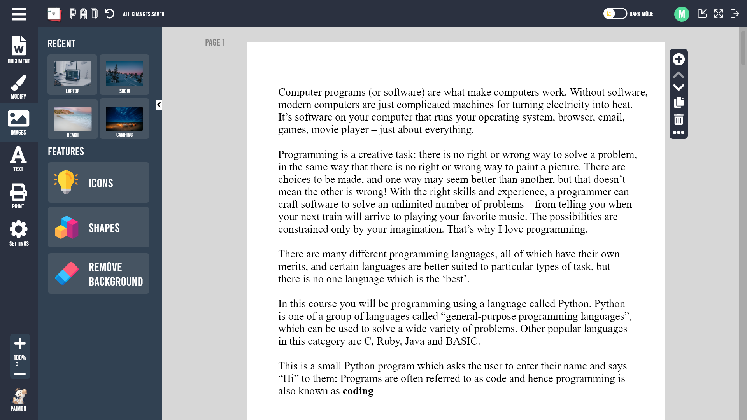
software
dashboard

Slide 12
DURAN, HANS
FEROLINO, JOHN CHRISTOPHER
DATOY, JILCRES
ENGBINO, KAYE
THE TEAM
GABUTAN, MEL JEFFERSON
software

Slide 13
THE TEAM
DURAN, HANS
FEROLINO, JOHN CHRISTOPHER
DATOY, JILCRES
ENGBINO, KAYE
GABUTAN, MEL JEFFERSON

